Slide 1
SAML2.0
Creating Service Provider Application
ASP.NET Web Forms
Using ComponentSpace.dll

Slide 2
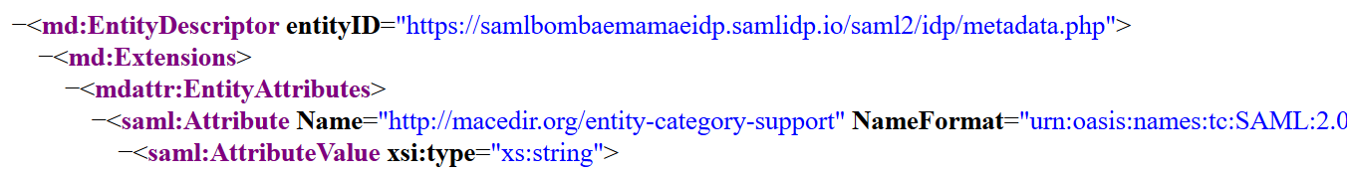
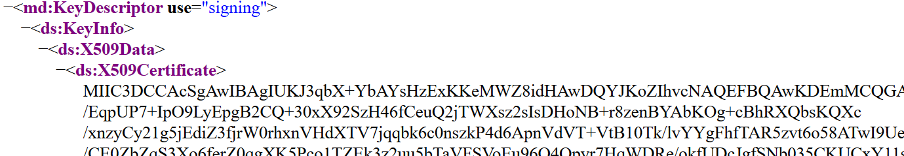
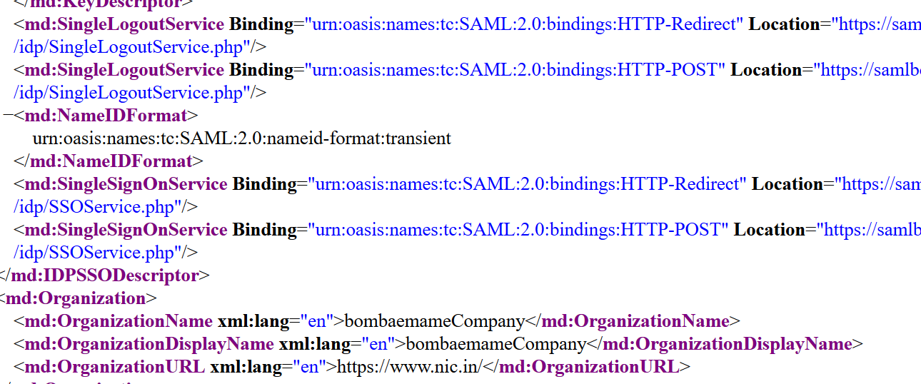
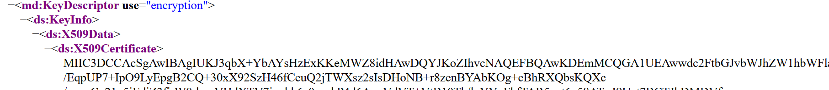
Trial Identity providers https://samlidp.io/idp/

Slide 3
This key is to be copied to my idp.cer, and this is the public key of My IDP.
How about this. . Does IDP use the same key for encryption??
Your reply :

Slide 4
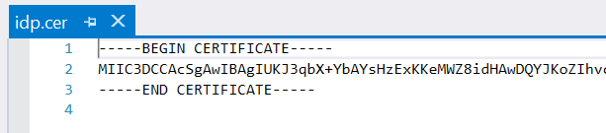
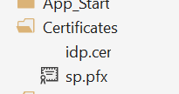
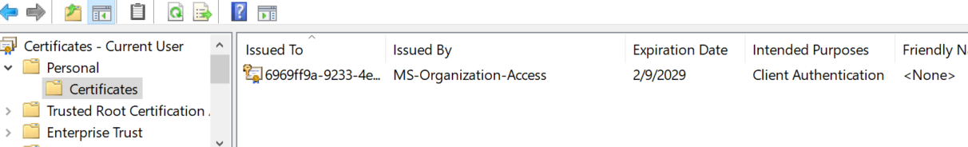
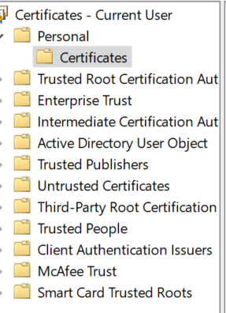
Copied the key to my idp.cer
I do not know where from I can get this key.
I am creating a service provider app, so this key is my local machine private key
or something else.
Please guide me on this..
Your reply :

Slide 5
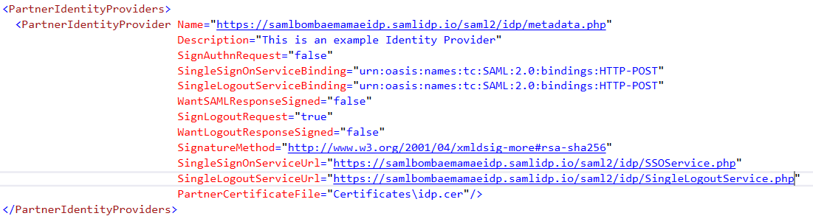

Slide 6
I have learned about HTTP-POST, Artifact, Redirect bindings..
On using HTTP-POST what features I wont get…??
Answer :
Can I use HTTP-POST with SignAuthRequest = true , wantSAMLResponseSIgned = true, wantLogoutResponseSigned = true?
If not why?
Answer:
And if I use Redirect bindings what changes are to be made ?
Answer :

Slide 7
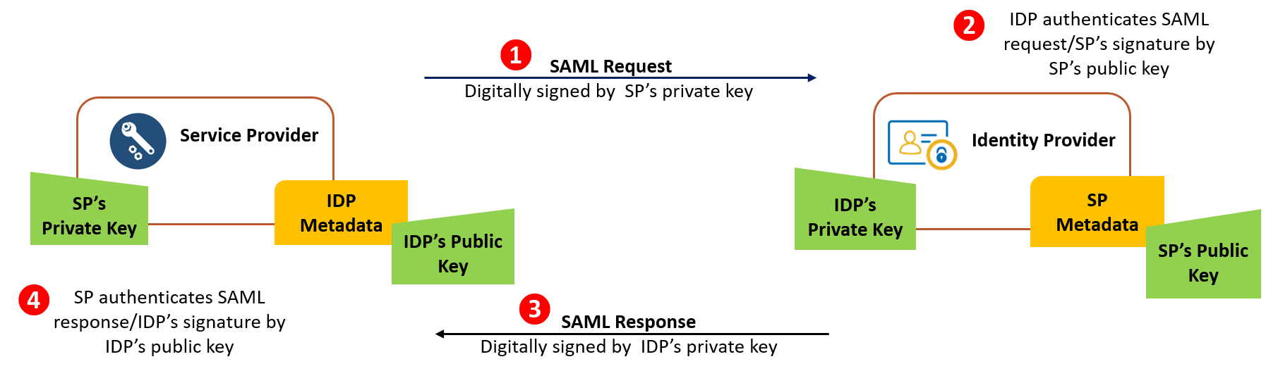
So, I am using the public key of my IDP to authenticate SAML response….
So I need to even provide service Provider public key to IDP for authenticating SAML request…so where I can find both private and public key..?
Answer:

Slide 8
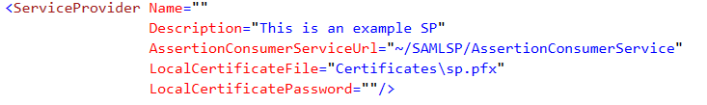
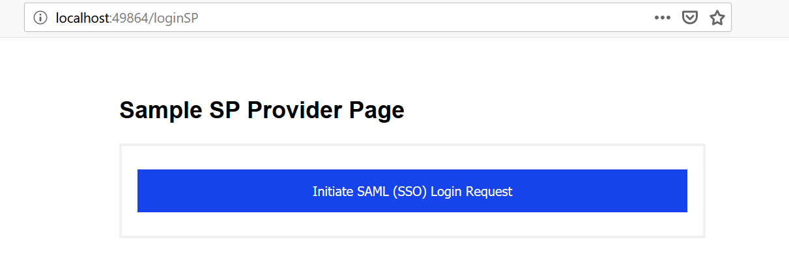
What name I should provide here…is it application name i.e
http://localhost:49864/loginSP
Answer :
Please assist me on local certificate or sp.pfx
Answer:

Slide 9
IDP
My Service Provider app
As of now I am using my Service provider app to authenticate users.
How to access my Service Provider app from my other web applications….
Answer : a short hint to make me understand.
IDP
Abc web app
My Service Provider app

